Slide 1
The diagram below describes a cause that led to the writing of the Declaration of Independence. Which action completes the diagram?
Colonial agricultural trade increased.
Colonial religious devotion increases.
Colonial demand for political change increases.
Colonial demand for military assistance increases.

Slide 2
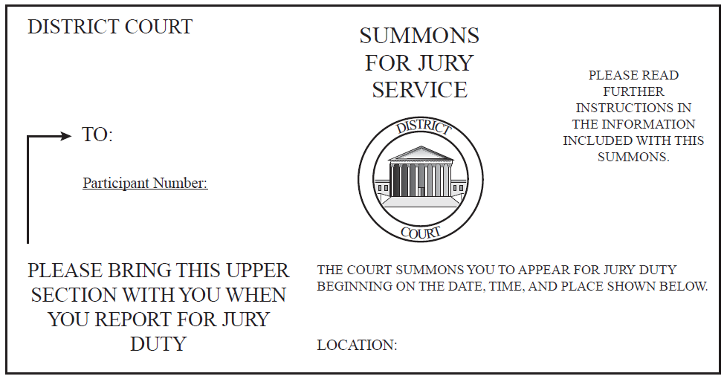
The illustration below shows a legal document. Why are citizens obligated to respond to such documents?
to guarantee court hearings remain public
to guarantee courts provide probable cause
to protect the constitutional right to be tried by one’s peers
to protect the constitutional right to confront one’s accuser

